Slide 1

HOSPITAL MANAGEMENT SYSTEM
Presented to
Prof. Md Mushfique Anwar
Lec. Rumana Yasmin
1

Slide 2






TEAM MEMBER:
Mohaiminul Islam Raju
ID: 2252421020
Shamoyeta Mourin Mouly
ID: 2252421036
Latifa Nishat Nishi
ID: 2252421062
Tahsina Tabassum Roza
ID: 2252421084
Raiyan Bin Sarwar
ID: 2252421096
2

Slide 3

TABLE OF CONTENT
INTRODUCTION
FEATURES
FUNCTIONAL & NON-FUNCTIONAL REQUIREMENT
UML USE CASE DIAGRAM
EXTENDED USE CASE
UML CLASS DIAGRAM
DATA FLOW DIAGRAM
DATABASE SCHEMA
TEST SUITE
IMPLEMENTATION DETAIL (UI DESIGN)
TOOLS USED
CONCLUSION
REFERENCES
3

Slide 4

INTRODUCTION
OUR PROJECT, HOSPITAL MANAGEMENT SYSTEM (HMS), IS A WEB-BASED SOLUTION DESIGNED TO STREAMLINE HOSPITAL OPERATIONS BY DIGITIZING KEY PROCESSES LIKE PATIENT MANAGEMENT, APPOINTMENT SCHEDULING, BILLING, DIAGNOSTICS, AND STAFF COORDINATION. IT ENHANCES EFFICIENCY, ACCURACY, AND ACCESSIBILITY ACROSS ALL DEPARTMENTS, ENSURING BETTER PATIENT CARE AND SMOOTH ADMINISTRATIVE WORKFLOW.
4

Slide 5
FEATURES
APPOINTMENT & SCHEDULING SYSTEM
PATIENT HISTORY / ELECTRONIC HEALTH RECORD (EHR) MANAGEMENT
MEDICATION STORE
DIAGNOSTIC SERVICES
AMBULANCE BOOKING
ROLE-BASED LOGIN
STAFF MANAGEMENT
ROOM ALLOCATION
PRESCRIPTION MANAGEMENT
BILLING AND PAYMENT SYSTEM
5

Slide 6

FUNCTIONAL AND NON-FUNCTIONAL REQUIREMENT
FUNCTIONAL REQUIREMENT
A functional requirement defines what a system should do — its specific features, functions, or behaviors.
NON-FUNCTIONAL REQUIREMENT
A non-functional requirement defines how a system should perform — its quality attributes like speed, security, or usability.
6

Slide 7
FUNCTIONAL REQUIREMENT
Appointment Booking:
Patient Online Booking
User Story: As a patient, I want to book an appointment online so that I can avoid long queues at the hospital.
Confirmation: When a patient submits a booking request with the required details (date, time, doctor), the system reserves the slot, displays a confirmation message with a unique appointment ID, and sends an SMS/email confirmation.
View Real-Time Calendar Slots
User Story: As a patient, I want to view a real-time calendar of available slots so that I can select a time that fits my schedule.
Confirmation: The system displays an up-to-date calendar reflecting current doctor availability when a patient accesses it.
7

Slide 8
FUNCTIONAL REQUIREMENT
Medication Store
View Medication Inventory
User Story: As a pharmacist, I want to view the current inventory so that I can manage stock efficiently.
Confirmation: The system provides an interface showing all available medications, quantities, and expiration dates.
Update Inventory Records
User Story: As a store manager, I want to update medication entries to reflect restocking or removal so that records stay current.
Confirmation: The system logs inventory updates with medication name, batch, and quantity adjusted.
8

Slide 9
NON-FUNCTIONAL REQUIREMENT
Performance: System responds within 2 seconds for most actions; supports 200+ concurrent users.
Security: Role-based access control, data encryption, and activity logging.
Reliability: 99.9% uptime with automated daily backups and fast disaster recovery.
Usability: Simple, responsive UI with accessibility features (e.g., for screen readers).
Scalability: Modular design that supports future expansion (e.g., adding new hospital departments).
Portability: Web-based system compatible with mobile, tablet, and desktop devices.
Maintainability: Well-documented code and modular structure for easy updates.
Auditability: Every user action is logged to ensure accountability and compliance.
9

Slide 10
UML USE CASE DIAGRAM
A UML Use Case Diagram illustrates the interactions between users (actors) and the system's functional processes. It helps visualize system requirements and user roles in a clear and structured way.
10

Slide 11
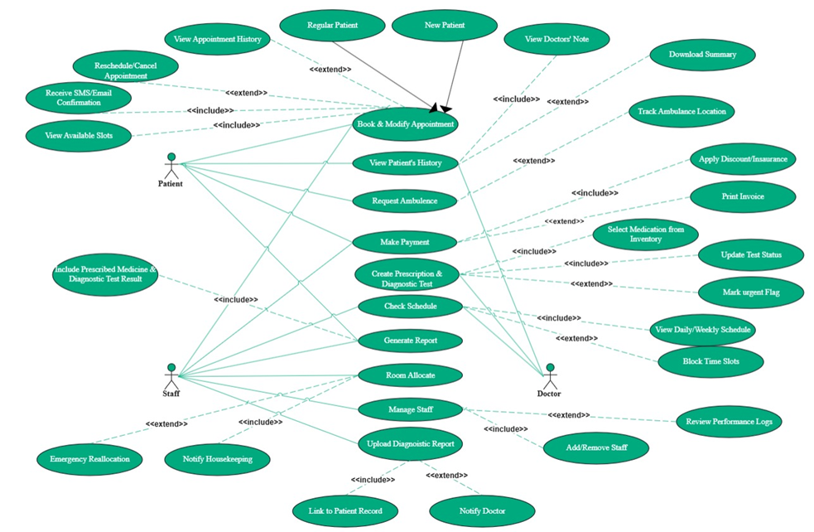
UML USE CASE DIAGRAM
11

Slide 12
EXTENDED USE CASE
Extended use cases define real-world hospital scenarios involving users and the system. They outline standard and exception workflows for key operations like appointments, billing, records, staff, diagnostics, and more—ensuring robust, user-centric functionality with clear preconditions and outcomes.
12

Slide 13
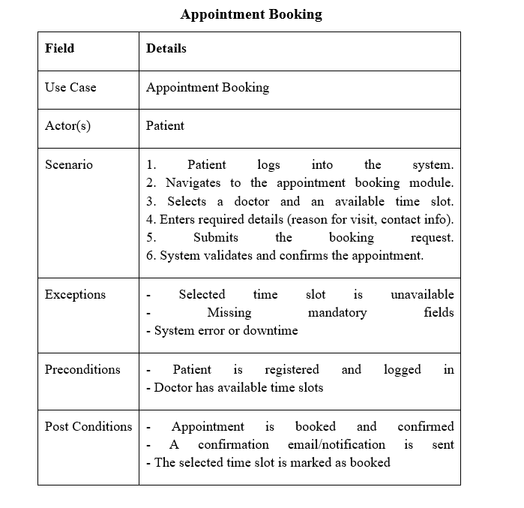
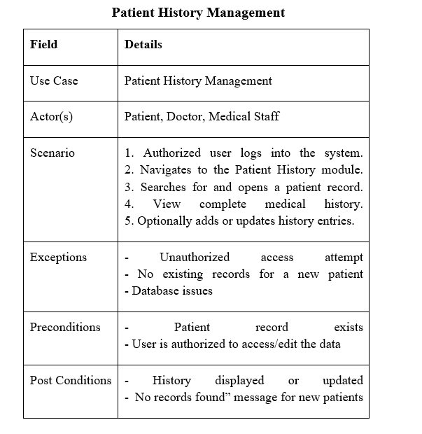
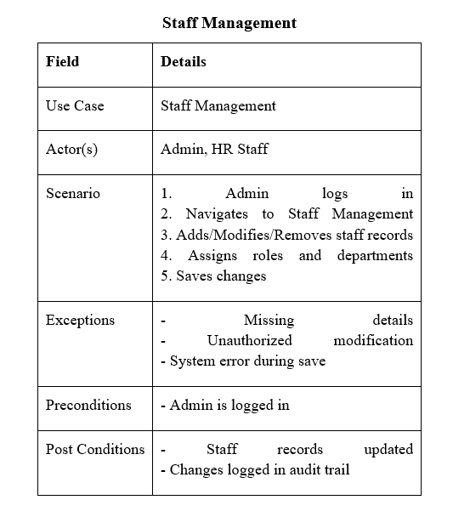
Extended Use Case
13

Slide 14
UML CLASS DIAGRAM
The class diagram provides a comprehensive structural overview of the Hospital Management System, illustrating the main entities (classes), their attributes, methods, and the relationships between them. This diagram captures both the inheritance hierarchy for users and the core domain interactions that support hospital operations.
14

Slide 15
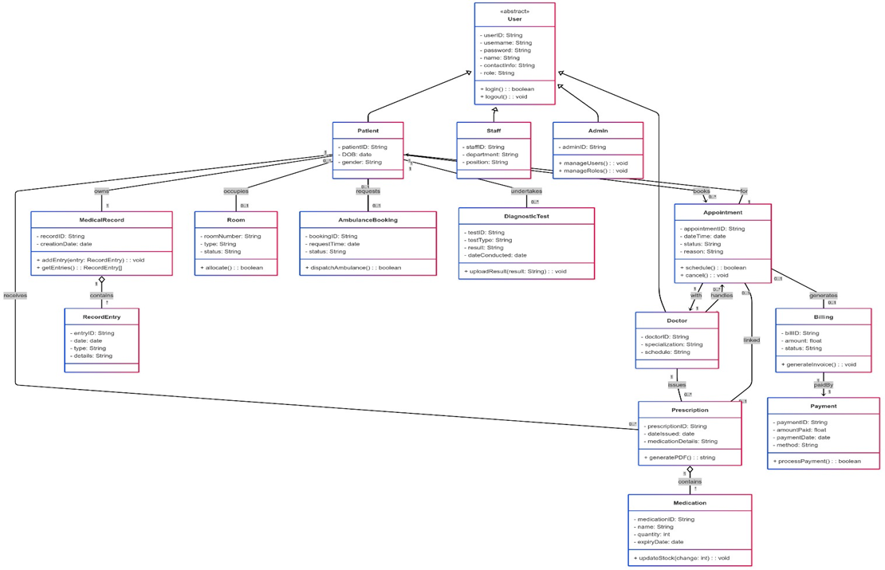
UML CLASS DIAGRAM
15

Slide 16
DATA FLOW DIAGRAM
The database schema defines the structured layout of all hospital data, linking users, patients, services, and transactions to ensure secure and efficient information management.
16

Slide 17
DATA FLOW DIAGRAM (DFD)
Level 0: Shows the entire system as a single process and its interaction with external entities like patients, doctors, and admins.
Level 1: Breaks down the main system into core modules such as appointments, billing, and records, showing data flow between them.
Level 2: Zooms into specific modules (e.g., Appointment Booking) to detail internal sub-processes and data stores.
17

Slide 18
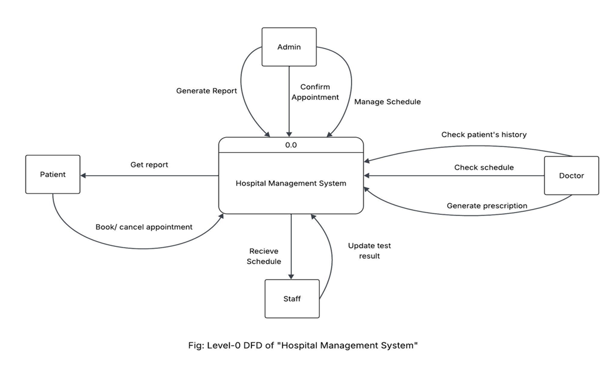
LEVEL 0 DFD
18

Slide 19
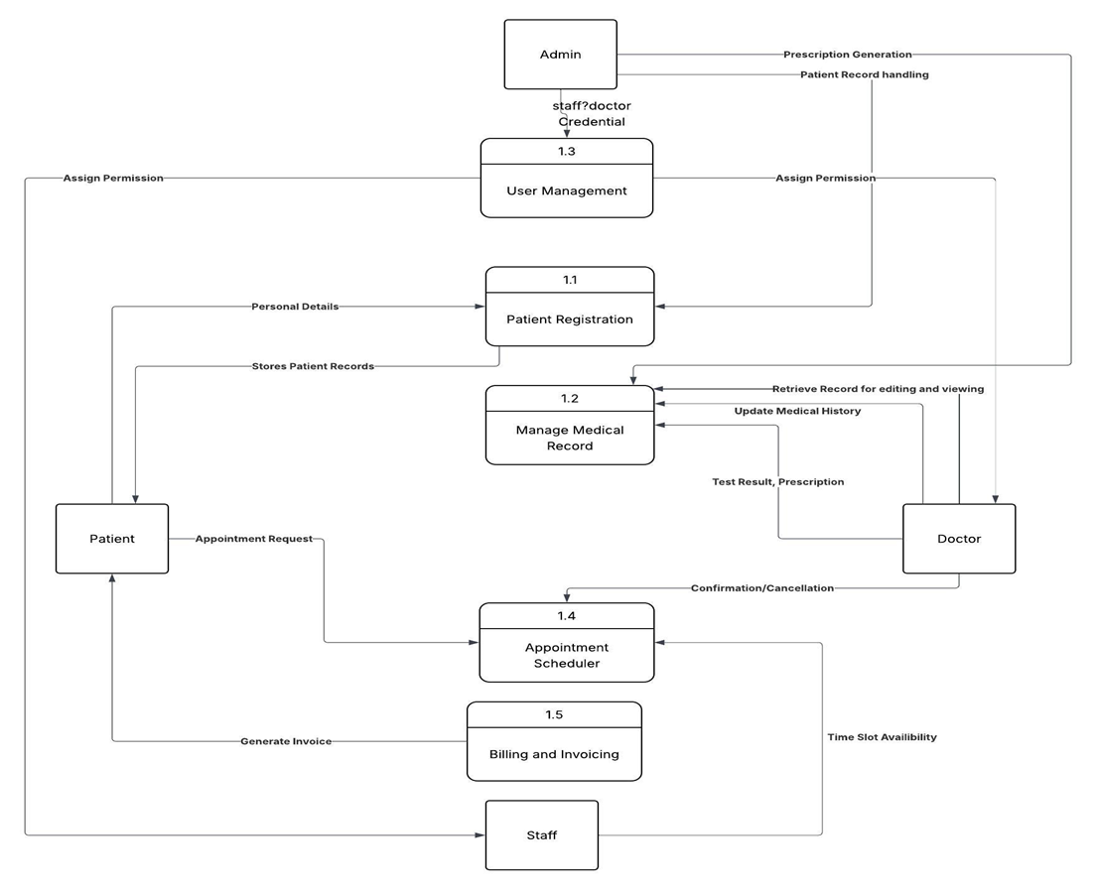
LEVEL 1 DFD
19

Slide 20
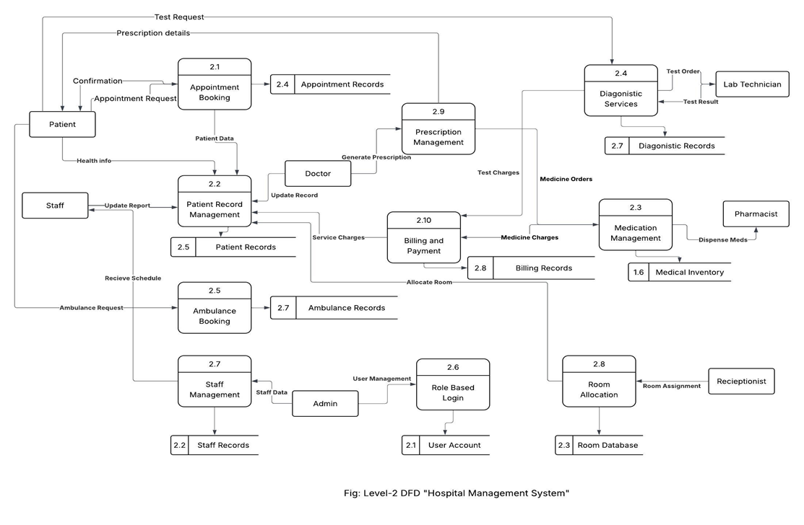
LEVEL 2 DFD
20

Slide 21

DATABASE SCHEMA
The database schema defines the structured layout of all hospital data, linking users, patients, services, and transactions to ensure secure and efficient information management.
21

Slide 22
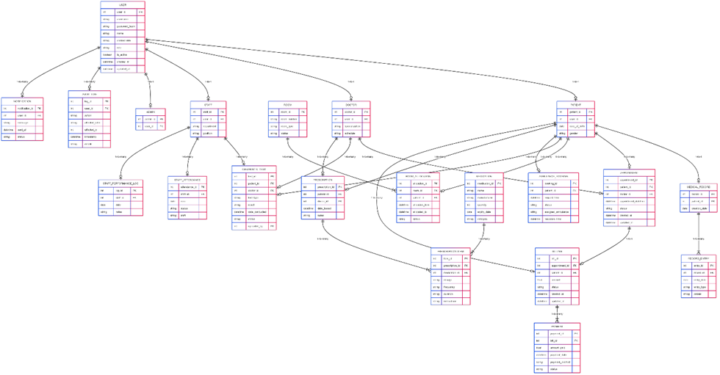
DATABASE SCHEMA
22

Slide 23
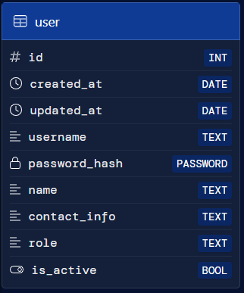
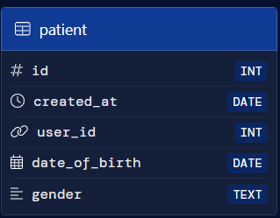
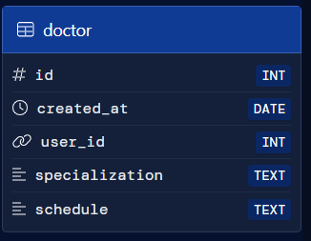
ENTITIES..
23

Slide 24
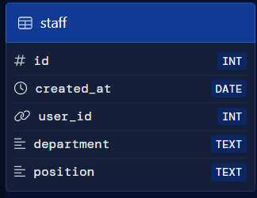
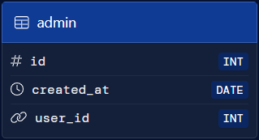
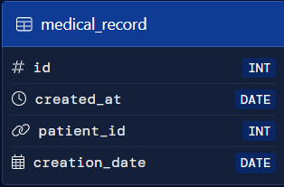
ENTITIES..
24

Slide 25

TEST SUITE
The test suite ensures all modules of the Hospital Management System function correctly through unit, integration, and system-level tests. It validates core features like appointment booking, billing, login, and medical record management under various scenarios.
25

Slide 26
TEST SUITE
Each Test Suite has
Objective
Preconditions
Test Steps
Expected Outcome
26

Slide 27
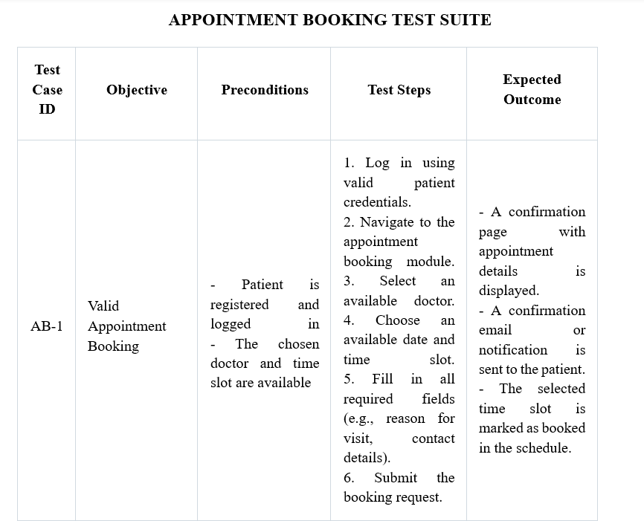
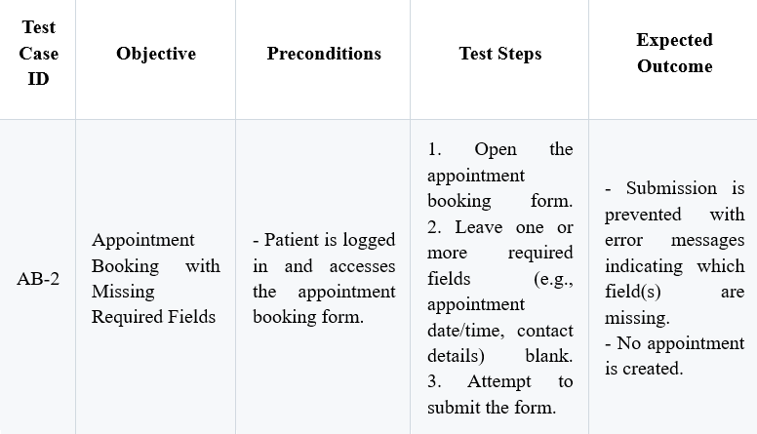
APPOINTMENT BOOKING TEST SUITE
27

Slide 28
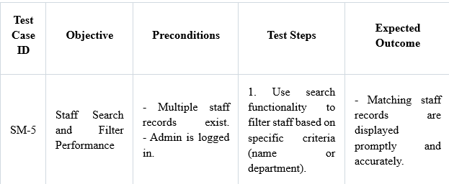
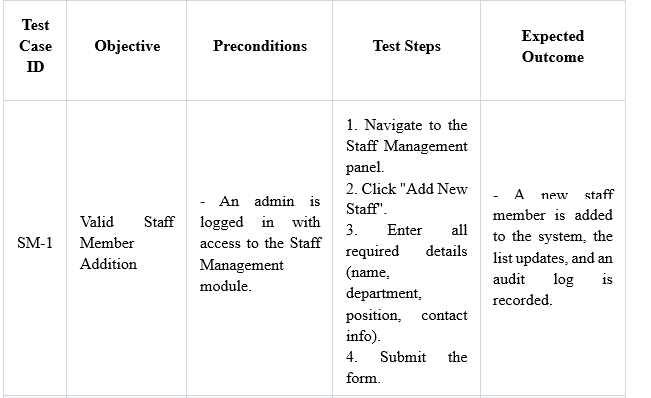
STAFF MANAGEMENT TEST SUITE
28

Slide 29
IMPLEMENTATION DETAIL (UI DESIGN)
UI design (User Interface design) is the process of creating visually appealing and user-friendly interfaces for software applications. It focuses on the layout, look, and interactive elements to ensure users can easily navigate and interact with the system, enhancing usability and overall user experience.
29

Slide 30
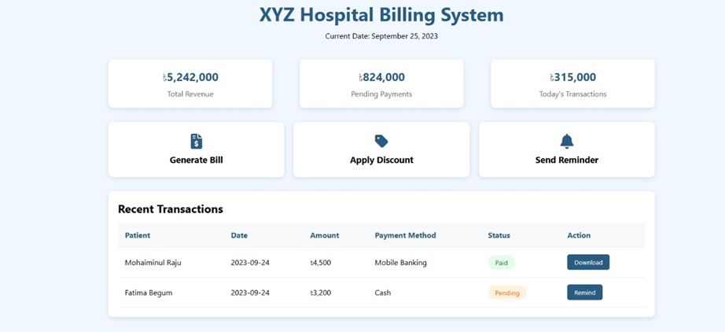
UI DESIGN (BILLING & PAYMENT SYSTEM)
30

Slide 31
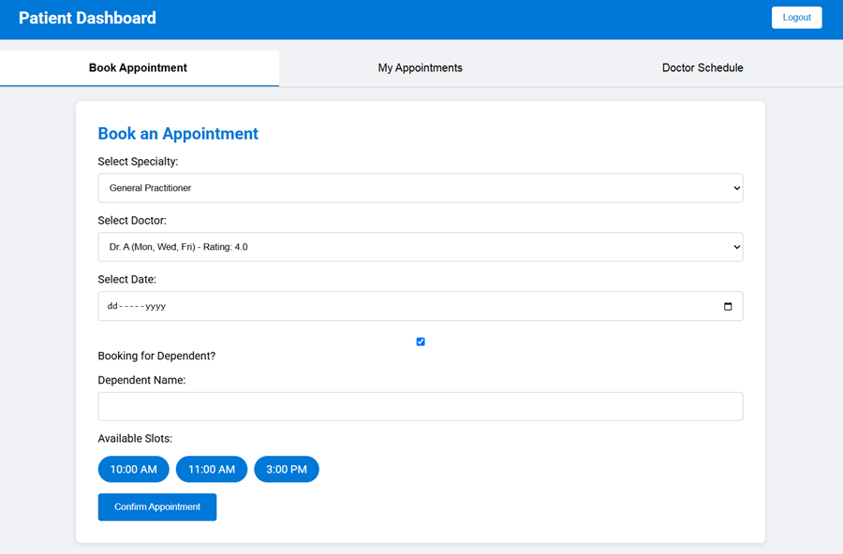
UI DESIGN (APPOINTMENT BOOKING)
31

Slide 32
TOOLS USED
COMMUNICATION, TASK MANAGEMENT & DISCUSSION TOOLS
Trello
Discord
UML DIAGRAM TOOLS
MermaidChart
StarUML
Lucidchart
draw.io
UI DESIGN TOOLS
HTML and CSS
Figma
32

Slide 33
CONCLUSION
The Hospital Management System project successfully digitalizes key hospital operations, enhancing efficiency and patient care. With a user-friendly design, strong architecture, and thorough testing, it stands as a reliable, scalable solution for modern healthcare needs.
33

Slide 34
THANK YOU
34

Slide 35
REFERENCES
Hospital Management System Project in Software Development (with ER diagrams and concepts) – GeeksforGeeks
https://www.geeksforgeeks.org/hospital-management-system-project-in-software-development/
Hospital Management System: A Step-by-Step Development Guide – MindInventory
https://www.mindinventory.com/blog/hospital-management-software-development/
How to Develop Hospital Management System in 2025: The Full Guide – Cleveroad
https://www.cleveroad.com/blog/how-to-develop-hospital-management-system/
How To Develop Hospital Management System: A Detailed Guide – The Algo
https://www.the-algo.com/post/how-to-develop-hospital-management-system-a-detailed-guide
Hospital Management Software Development: A Step-by-Step Guide – DjangoStars
https://djangostars.com/blog/hospital-management-software-development/
Trello Board - G-3 Hospital Management System
35

Slide 36
REFERENCES (CONT..)
Discord Communication Channel
https://discord.com/channels/1360408648886522158/1360409297783357703
draw.io (diagrams.net)
https://www.diagrams.net/
Figma
https://www.figma.com/
MermaidChart Project Workspace
https://www.mermaidchart.com/
LucidChart
https://www.lucidchart.com/pages
Course lecture notes and recommended software engineering textbooks.
Software Engineering (10th Edition) by Ian Sommerville.
ISBN: 978-0133943030
36

